Slide 1
The Influence of Environment on Audiovisual Subjective Tests
AGH, NTIA, Intel, IRCCyN,
Opticom, Technicolor

Slide 2
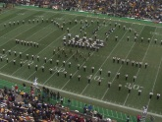
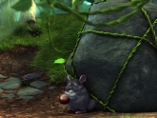
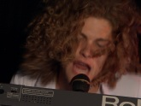
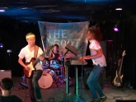
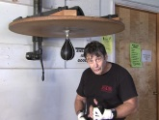
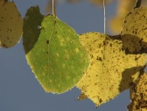
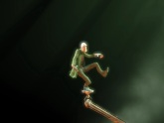
Experiment Design
Wide Range of Quality
Original—Heavily Compressed
VGA
60 clips
10 SRC
50% English Language
50% Music Only
ACR 5-level
Subjective test used light compression

Slide 3
Environment Variables
Country
Native language
Audio presentation device
Speakers / earbuds / headphones
Monitor size (7” to 42”)
Viewing distance, angle (8º to 20º)
Screen brightness, color (calibrated, default)
Lighting (20 lux to 200 lux)
Controlled laboratory / public area

Slide 4
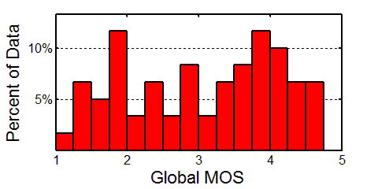
Environments
10 datasets
6 Labs
6 Controlled Environments
4 Public Environments

Slide 5
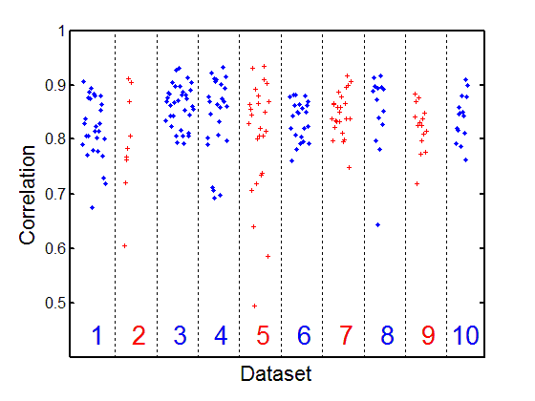
Subjects
NTIA
NTIA public
Intel
IRCCyN
IRCCyN public
Technicolor
Technicolor public
AGH
AGH public
OPTICOM

Slide 6
Dataset Correlations
 | 1 | 2 | 3 | 4 | 5 | 6 | 7 | 8 | 9 | 10
1 | 1.00 | 0.95 | 0.98 | 0.97 | 0.97 | 0.97 | 0.98 | 0.97 | 0.96 | 0.95
2 | 0.95 | 1.00 | 0.95 | 0.94 | 0.94 | 0.93 | 0.96 | 0.94 | 0.93 | 0.93
3 | 0.98 | 0.95 | 1.00 | 0.98 | 0.98 | 0.98 | 0.99 | 0.98 | 0.97 | 0.97
4 | 0.97 | 0.94 | 0.98 | 1.00 | 0.98 | 0.96 | 0.97 | 0.97 | 0.96 | 0.96
5 | 0.97 | 0.94 | 0.98 | 0.98 | 1.00 | 0.96 | 0.97 | 0.96 | 0.97 | 0.96
6 | 0.97 | 0.93 | 0.98 | 0.96 | 0.96 | 1.00 | 0.99 | 0.97 | 0.97 | 0.95
7 | 0.98 | 0.96 | 0.99 | 0.97 | 0.97 | 0.99 | 1.00 | 0.97 | 0.97 | 0.96
8 | 0.97 | 0.94 | 0.98 | 0.97 | 0.96 | 0.97 | 0.97 | 1.00 | 0.96 | 0.96
9 | 0.96 | 0.93 | 0.97 | 0.96 | 0.97 | 0.97 | 0.97 | 0.96 | 1.00 | 0.97
10 | 0.95 | 0.93 | 0.97 | 0.96 | 0.96 | 0.95 | 0.96 | 0.96 | 0.97 | 1.00
# | 28 | 9 | 34 | 25 | 25 | 24 | 24 | 15 | 14 | 15

Slide 7
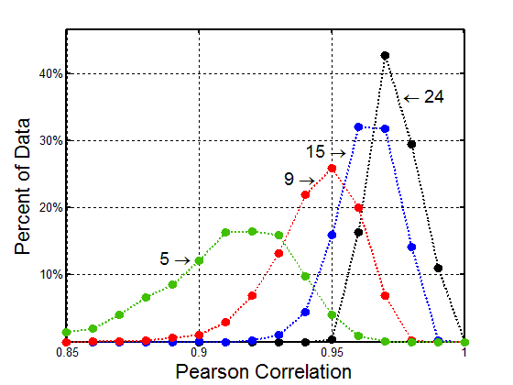
Number of Subjects

Slide 8
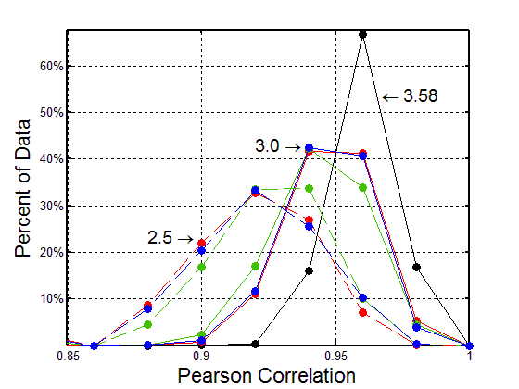
Range of MOS

Slide 9
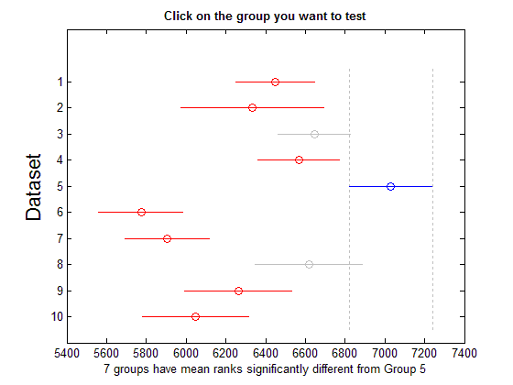
Kruskal-Wallis
NTIA
NTIA public
Intel
IRCCyN
IRCCyN public
Technicolor
Technicolor public
AGH
AGH public
OPTICOM

Slide 10
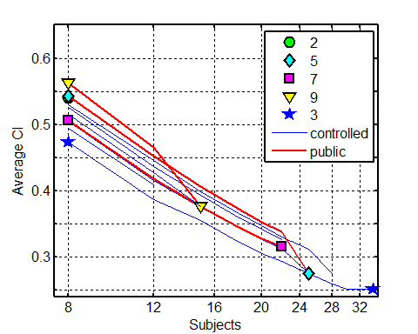
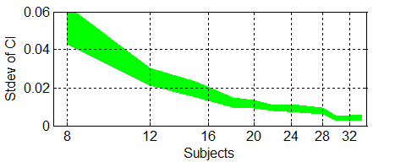
Confidence Interval (CI) Number of Subjects
CI drops as number of subjects increases
1/sqrt(N)

Slide 11
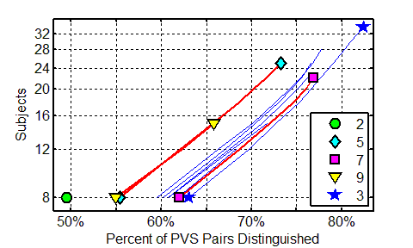
Discrimination Power
Blue Controlled
Red Public
Controlled → Similar Performance
Public → Need More Subjects
24 in Controlled
35 in Public

Slide 12
Different Conclusions
Percent of Trials
One dataset distinguished between PVS pairs; and the other dataset did not
Opposite conclusions rare < 0.03%, 8 subjects
 | 1 | 3 | 4 | 6 | 7
1 |  | 14% | 15% | 16% | 13%
3 | 14% |  | 12% | 11% | 10%
4 | 15% | 12% |  | 16% | 13%
6 | 16% | 11% | 16% |  | 10%
7 | 13% | 10% | 13% | 10%

Slide 13
Factors Obscured by Personal Opinion
Native language / speech comprehension
Culture / country of origin
Lighting
Background noise
Wall color
Objects on the wall
Viewing distance
Monitor calibration
Color blindness
Vision good but not 20/20
Hearing (not tested)
Translation of ACR scale labels

Slide 14
Conclusions
Most Important Variables
Total Number of Subjects
People—opinions differ among subjects
MOS appears relative
Order of impairments consistent
Use same subjects when comparing factors
Environment Constraints Significantly Less Impact on MOS than Differences Between People

